Slide 1
Award Winner
The Barrier Removal Award - Winner: 5G Rural Dorset & AssetHUB
DCIA Winner: Dorset Council & AssetHUB
The Award-Winning Asset and Connectivity Marketplace

Slide 2
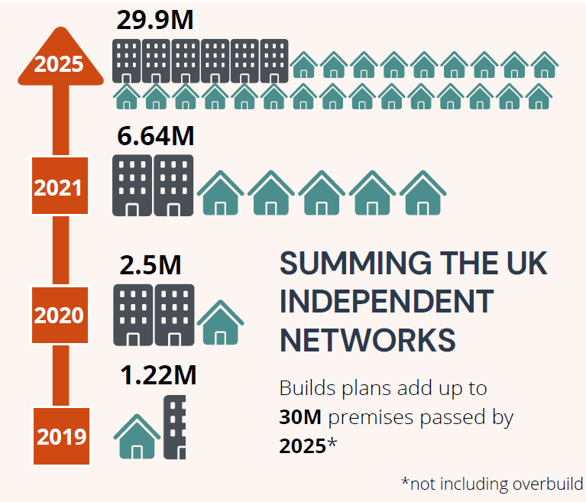
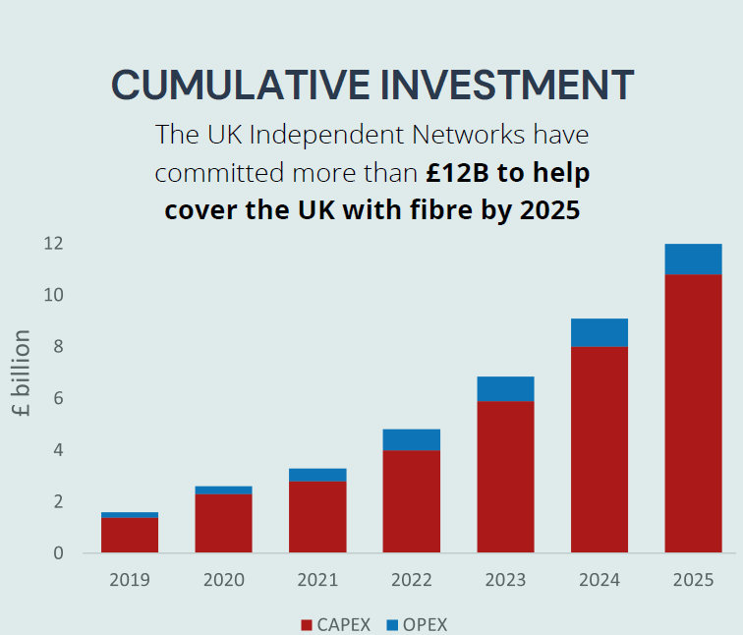
Solution to avoiding streetworks…
Public Sector:
Over 7.5m Street Lamps in the UK
Over 60,000 Public Sector buildings
Over 40,000Km Public Sector owned fibre and duct
Private Sector:
130+ Alt.nets pass 6.6m premises with Full Fibre (end 2021)
Aspiration to pass 30m premises by 2025
£Bn’s invested in alternate broadband networks since 2017
£Bn’s invested in 5G and IoT
Lots more investment, lots more build
Solution: Re-use existing assets
Reduce cost and speed up deployment

Slide 3
The Solution is a Problem
Different Asset Owners have:
Different processes
Different workflow
Different approvals
No common understanding of what is being bought and sold
Often require assets from multiple owners – making the problem worse
Public Sector less focussed on telecoms, and sometimes poor asset records
Security concerns around sharing asset info (overbuild, CNI etc)

Slide 4
The Solution: AssetHUB
Defines common set of products:
Dark Fibre, Ethernet, Site Access, Structure Access etc
Defines Standard Legal Contracts, T’s & C’s, SLA’s (Industry needs to agree)
Define Asset Security & Privacy Policy
Geo-location of Assets by address, postcode, coordinate, UPRNs etc
Add Supporting Datasets (AONB, SSSI, Utilities, Not-Spot data etc)
Business workflow, from Enquiry to Quote, Order to Contract
Full Audit trail of actions

Slide 5
AssetHUB
Customer Scenario
End customer
Buyers
Sellers
I need Dark Fibre
between x and y
We don’t have Dark Fibre between x and y. Let’s check with AssetHUB to see who has….
1
2
Dear Buyer. You can rent Dark Fibre between x and y from us for £x/Year
OK Alt.net A has Dark Fibre between x and y.
3
Let’s ask them for a quote.
4
4
We accept the quote, here’s a PO
5
5
6
Contract received & stored
7
7
Contract received & stored
8
Dear End Customer - we can provide you with Dark Fibre between x and y for £x/Year

Slide 6
AssetHUB Advantages
Buyers:
Market transparency
Competitive price
One contract partner
Cost savings
Sellers:
Additional sales channel
Efficient use of assets
New revenue opportunities
Legal
Market Benefits:
Efficient use of assets
Better coverage faster
Levelling up
Lower cost of deployment

Slide 7
AssetHUB – what’s next?
DCIA Winner – with Dorset Council, BCP Council, Hampshire Council
Plus OS, CTIL, WIG, Cellnex and others
Utility Infrastructure
Fibre in Water – already mapping existing water infrastructure for potential use
Disused gas network infrastructure
Power Networks? Important for telecoms
IoT Sensors and supporting infrastructure (needs more fibre)
5G sites & networks
5G Buoys (no fibre but needs a network & infrastructure!)
NUAR?
APIs?
If interested, please contact me - Rob@asset-hub.co.uk

Slide 8
Award Winner
The Barrier Removal Award - Winner: 5G Rural Dorset & AssetHUB
DCIA Winner: Dorset Council & AssetHUB
Thankyou
The Award-Winning Asset and Connectivity Marketplace
Rob Leenderts – Founder & MD
Rob@asset-hub.co.uk

Slide 9
Product Matrix
Product
Category
Connectivity Access Products
Site Access Products
Passive Access
Duct and Dark Fibre
Active Access
Ethernet
Wavelength
Site & Node Access
Product
Type
Product
Dark Fibre Standard
Dark Fibre Premium
Duct Access Standard
Duct Access Premium
Ethernet Light
Ethernet Medium
Ethernet Premium
Carrier Ethernet MEF
Passive
Active
Site Access Area Node
Site Access MeetMe
Product
Variant
Mono
Pair
Mono
Redundant
Pair Redundant
Attributes
Technical Specifications (per product)
Variables
Variables (per product)
Attributes are fixed characteristics
that cannot be changed
Variable are selectable
features for a product

Slide 10
Framework agreement
Framework Agreement
Terms and Conditions
Service Specification
Service Level Agreement
Blanket
Agreement
Transmission
Passive
Transmission
Active
Co-location
Dark Fibre
Mono
Dark Fibre
Pair
Wavelength
Passive
Ethernet
Light/Medium/ Premium/MEF
Wavelength
Active
Co-location
Area nodes / MeetMe

