Slide 1





Avoiding Streetworks using alternative infrastructure
24-02-22
Chris Founds
Infrastructure Director – CJ Founds Associates and CNI Member

Slide 2


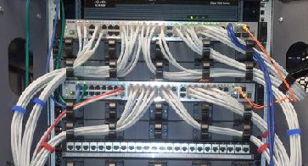

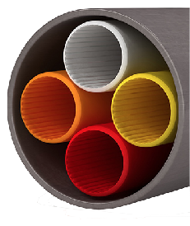
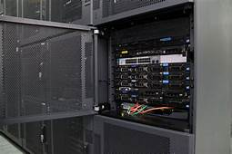

Cooperative Network Infrastructure - Model
ISP/operator
ISP/operator
ISP
ISP
ISP
Service layer
wholesale operator
Active layer
cooperative neutral host
Passive layers
Council
NHS
Social housing
Business park
Rack Space
Switching
DX FX PoP
Antenna Space
Wifi, fixed wireless and 5G
CNI Products
Dark Fibre
Duct Space
Notes:
Form
Co-operative Society under 2014 act
Regulated by the FCA
Governance
One member one vote
Elected board
Equity
Par-value, withdrawable (non-tradable) shares paying interest
Profits
Reinvest

Slide 3
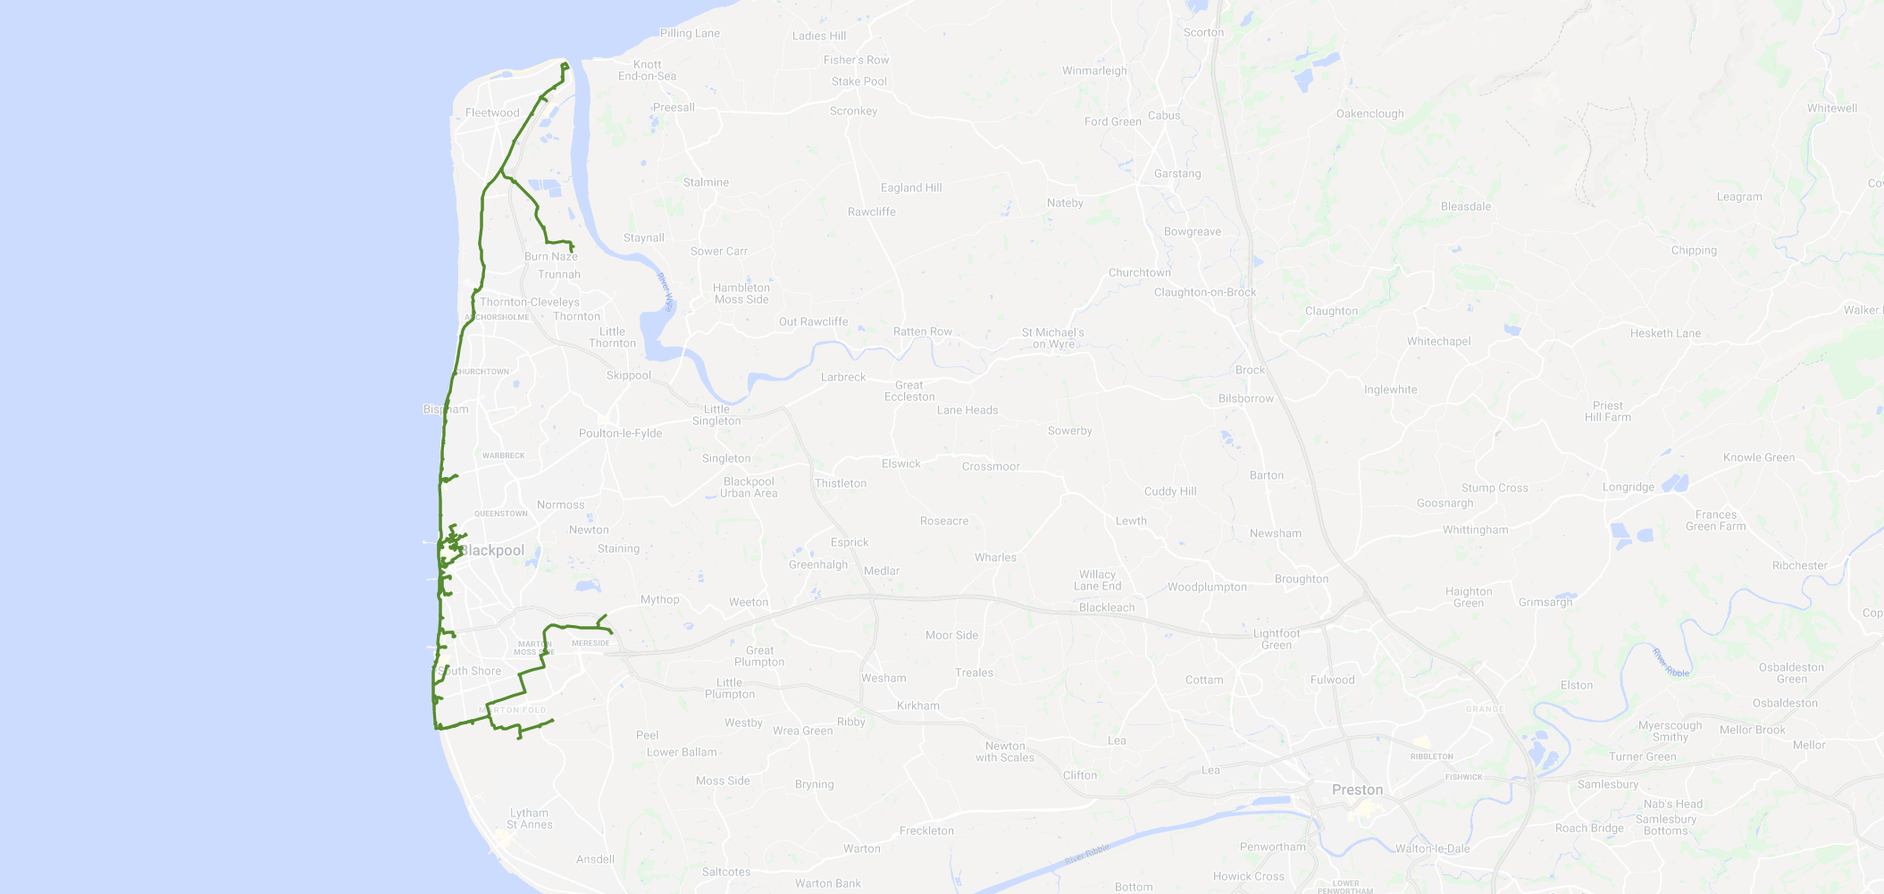
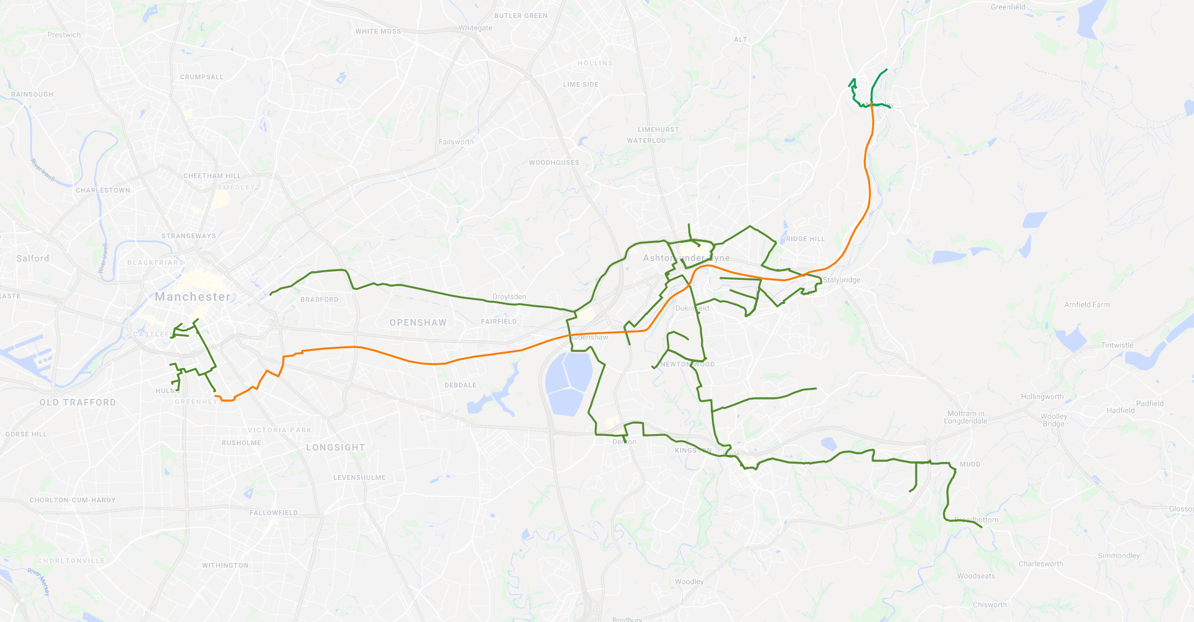

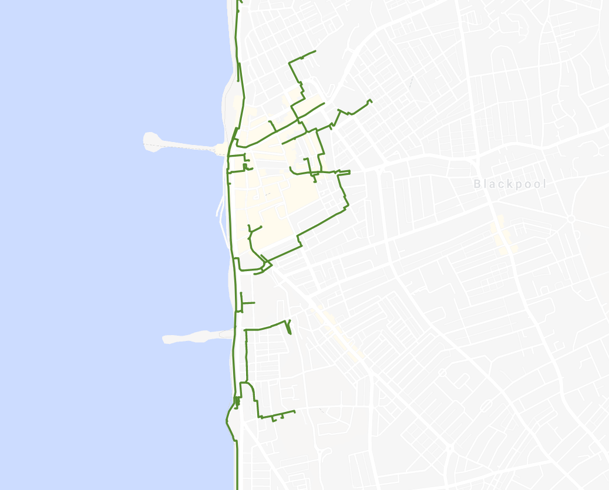
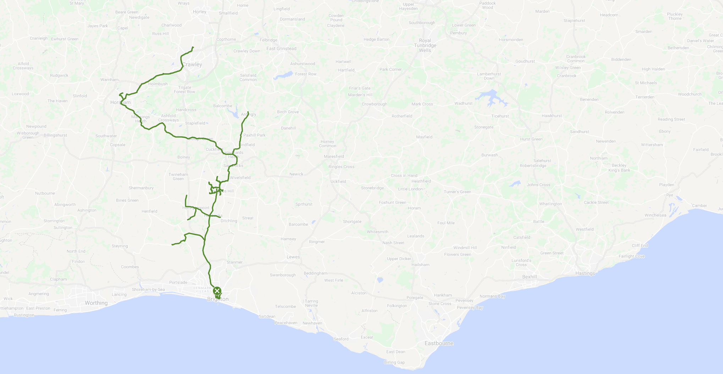
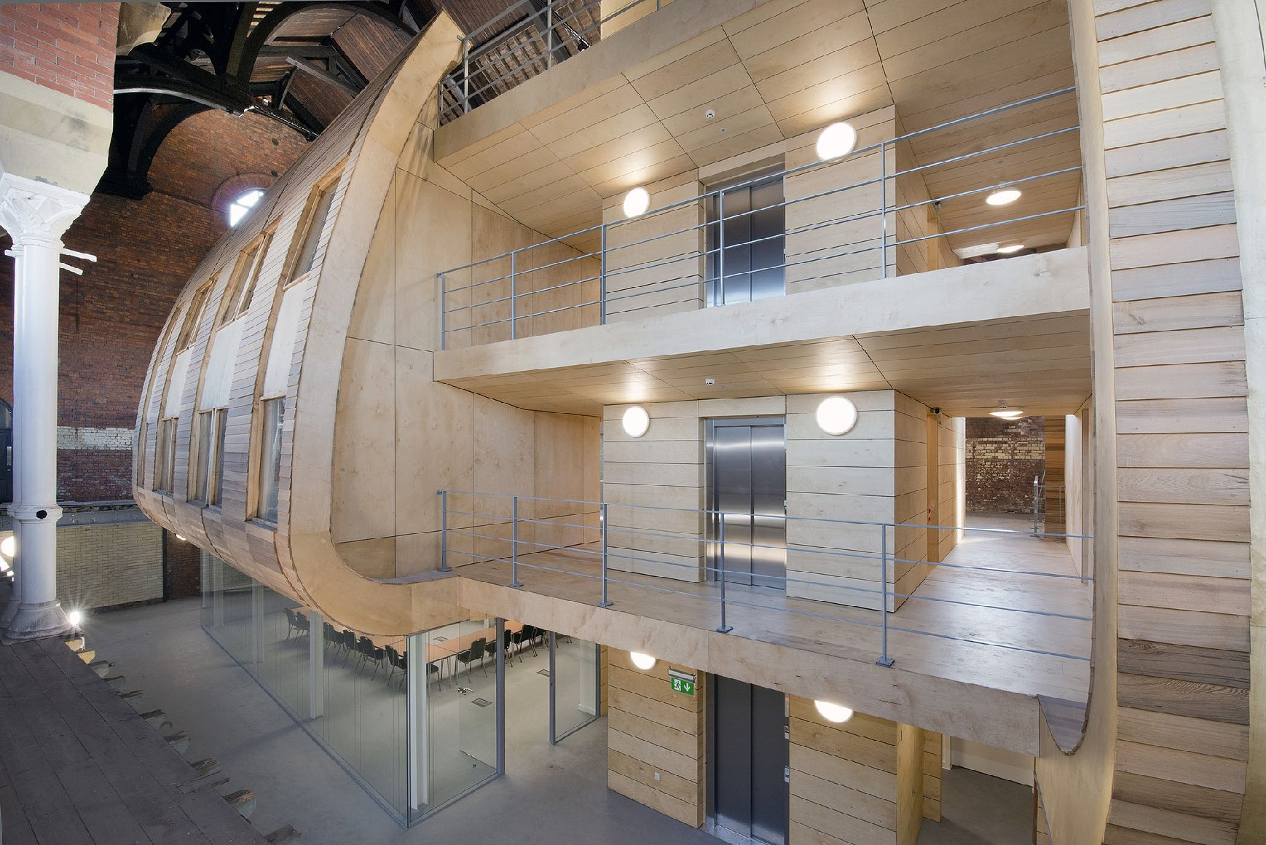

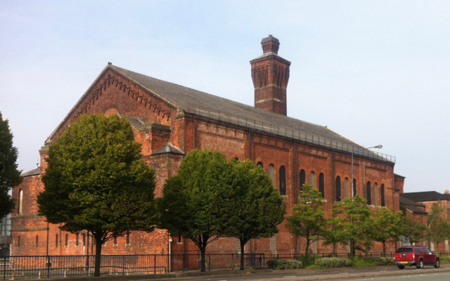
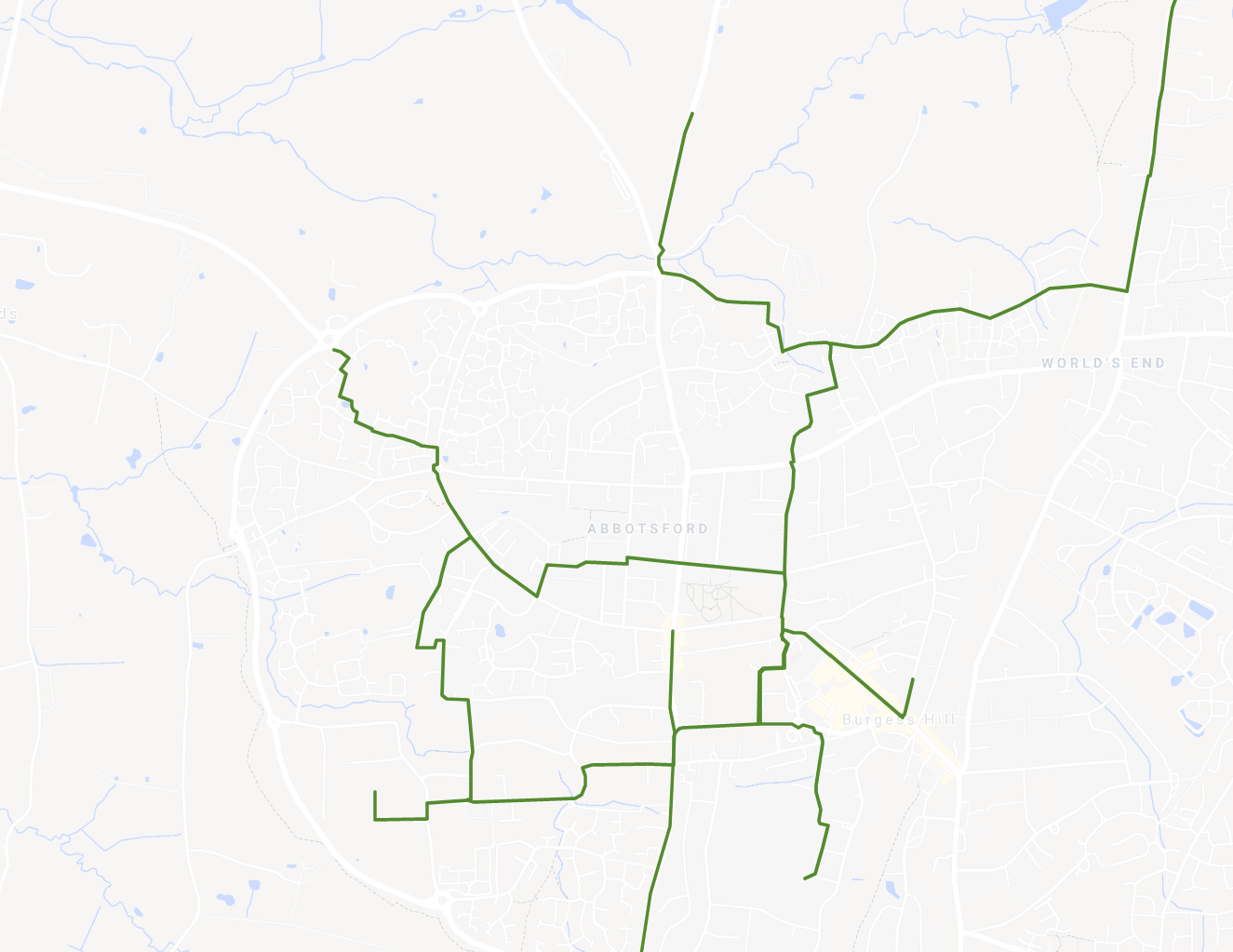

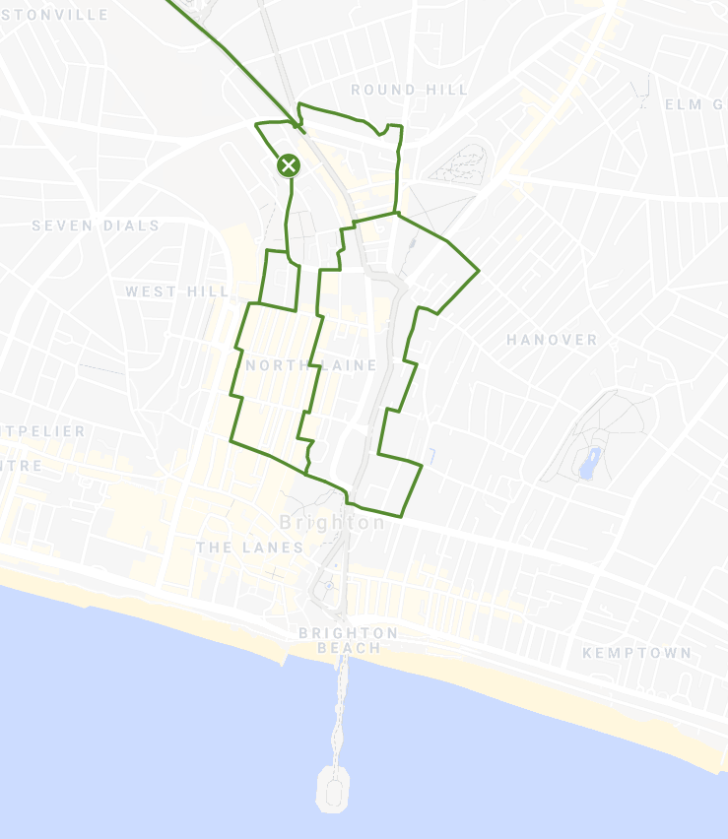
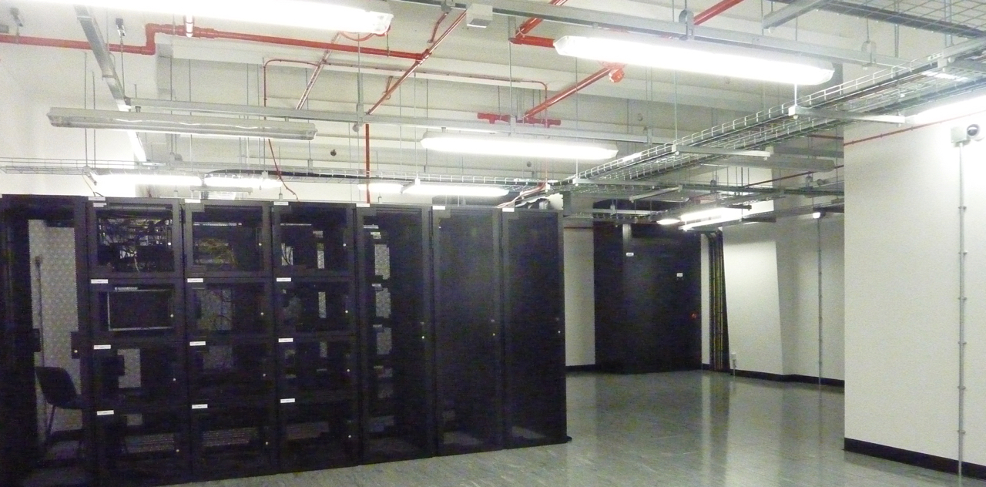
Blackpool and Fylde Coast
Tameside and Manchester
Sussex and Brighton
Notes:
Metrolink Asset Re-Use – Tameside Asset re-Use in Signals Ducting

Slide 4

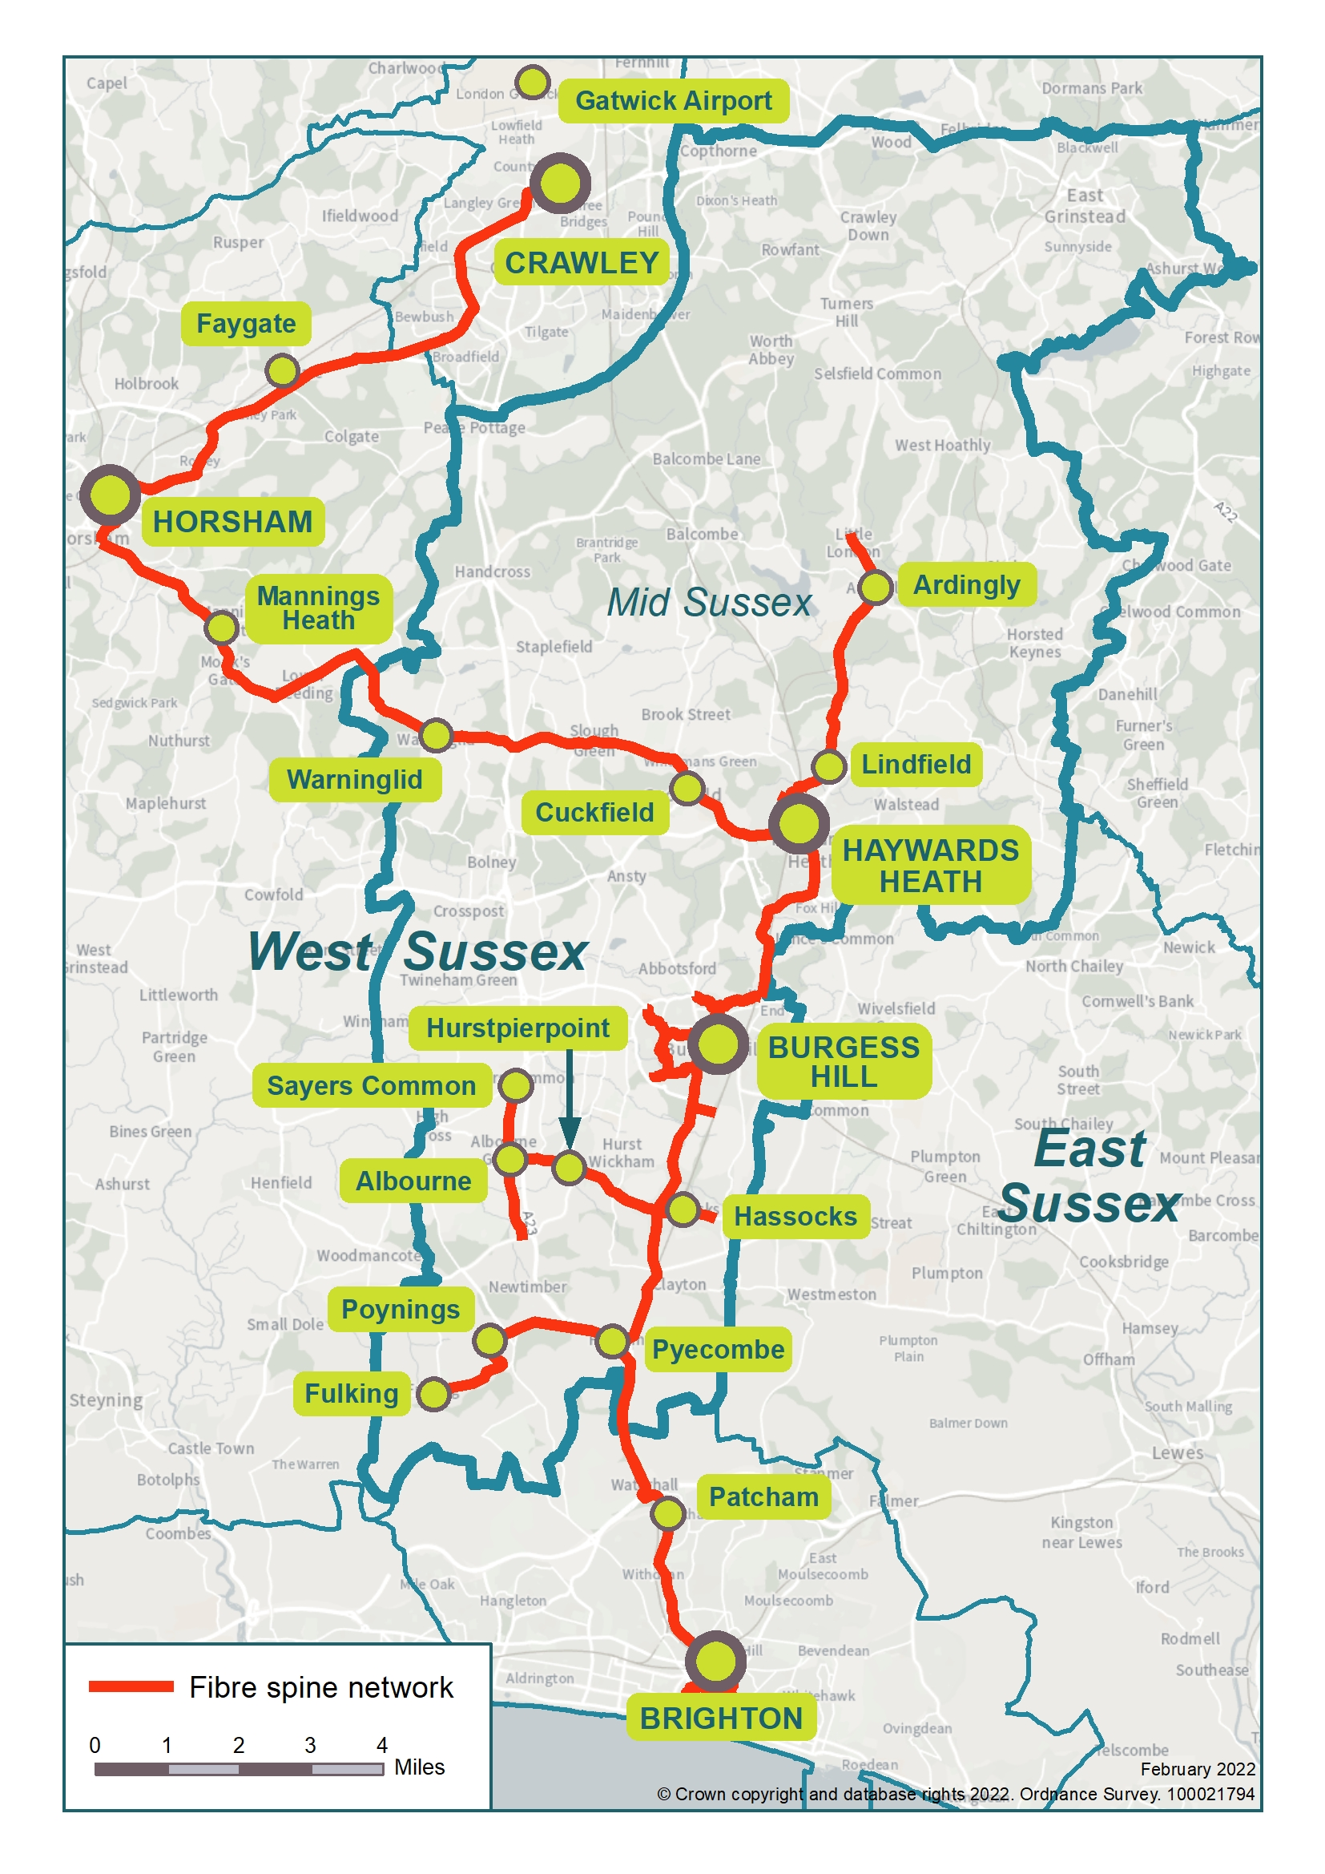
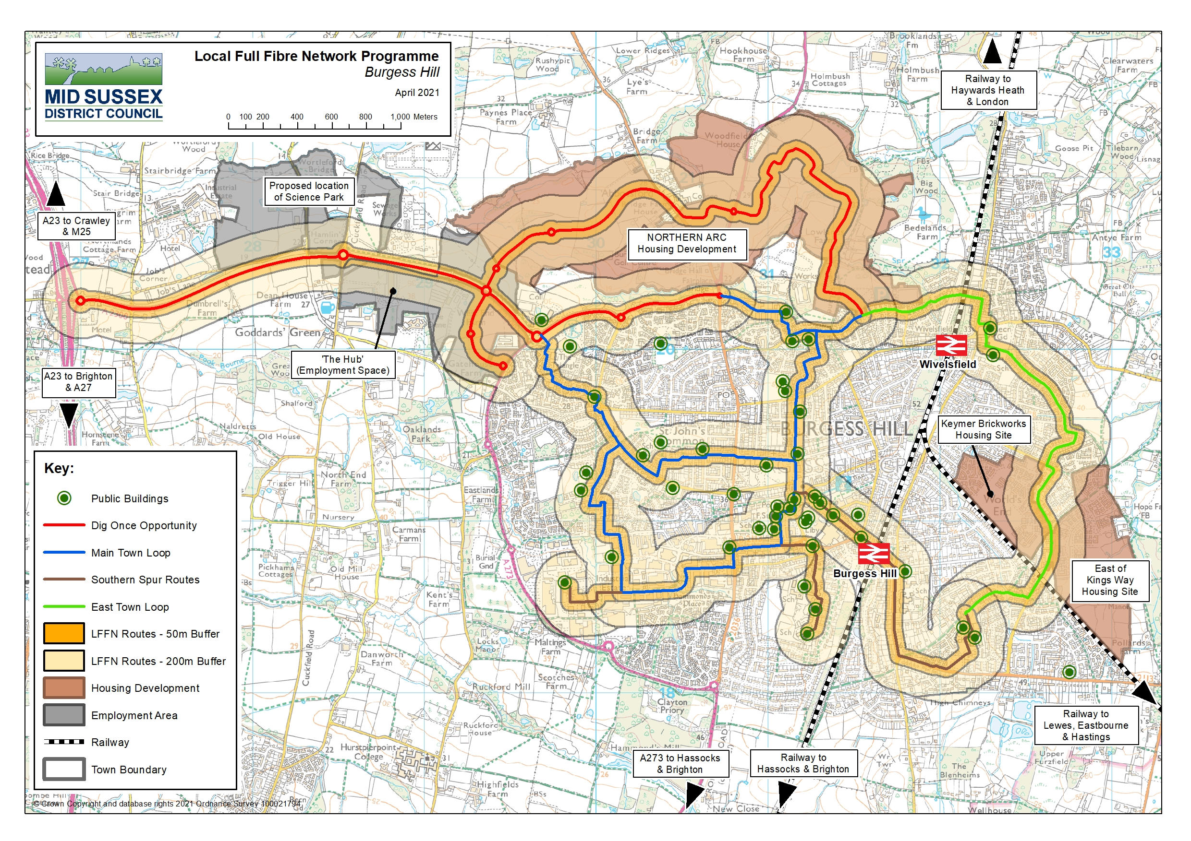
^{Digital Mid Sussex}
Burgess Hill Full Fibre Scaffold Network

Slide 5



Connecting People, Place and Policy
Planning Policy Adoption (using DP and PPG)
Digital provision within Mid Sussex District Plan DP23
Planning Policy Guidance 43 for Strategic Development Sites
Development Approach
Agreed digital provision at Pre-App Stage with Homes England
Section 38 adoption of network with Local Authority as asset owner
“Home-run” layout agreed under reserved matters for each plot/site
Fibre Network Principles
Open Access provision, limits Cabinets/space through design
Developer installs to MSDC Specification and MSDC/CNI adopt
Spine Access established under early enabler contract
Connection to wider Cooperative fibre network

Slide 6
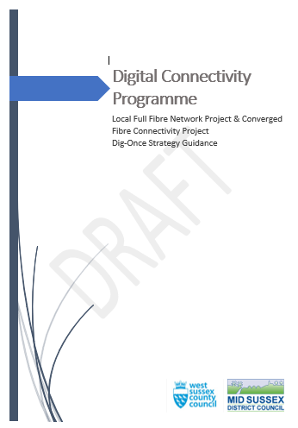


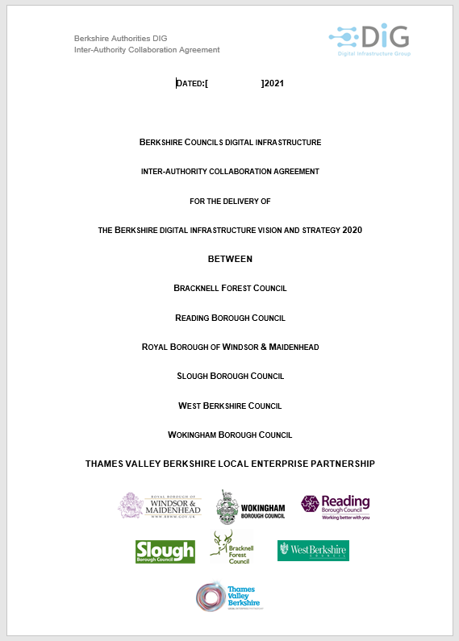


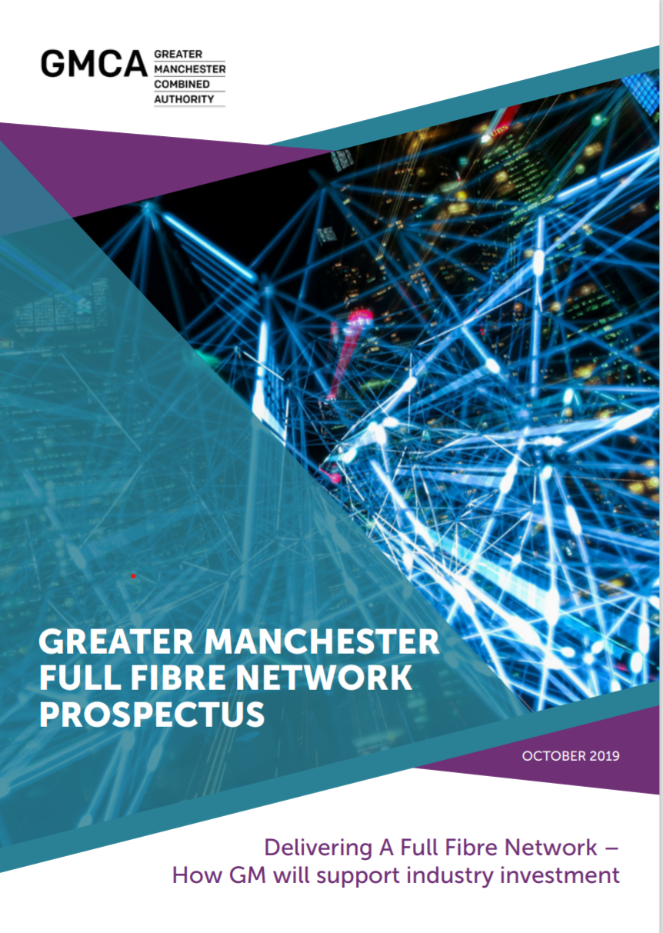


Other Local Authority Dig Once Enablers
Dig-Once Strategy
Dig-Once Policy Guidance
Candidate Appraisal Model
Supplementary Planning Guidance and PPG
Digital Prospectus
Developer Guide
Standardised Wayleaves
PIA Mutualisation Model
Notes:
Working with Highway and Planning teams

Slide 7
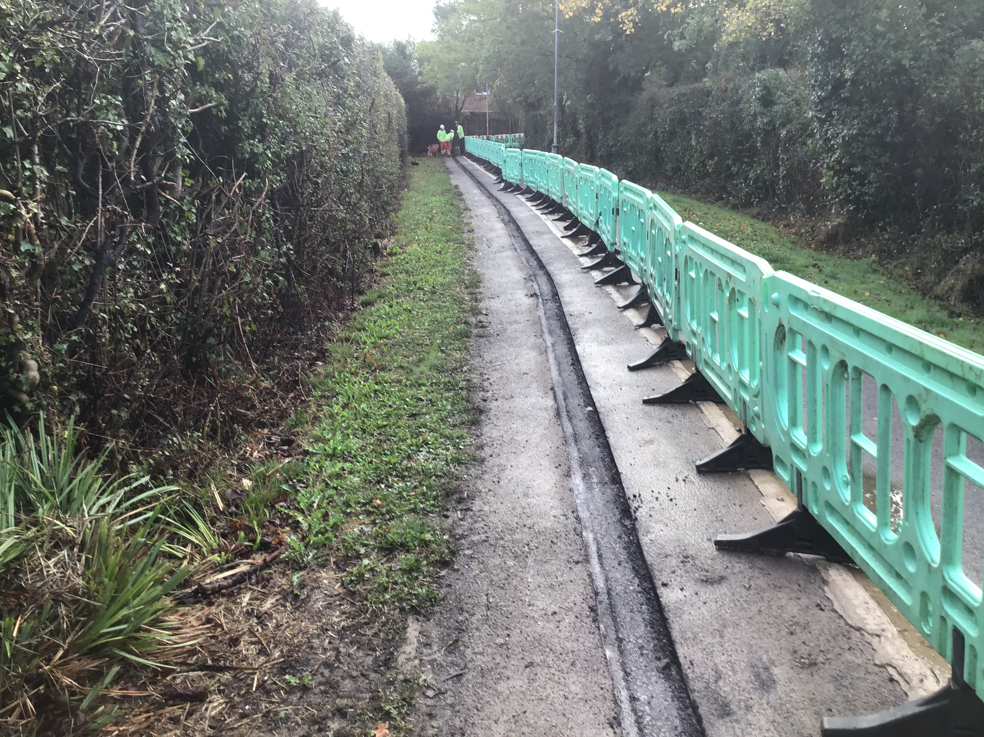
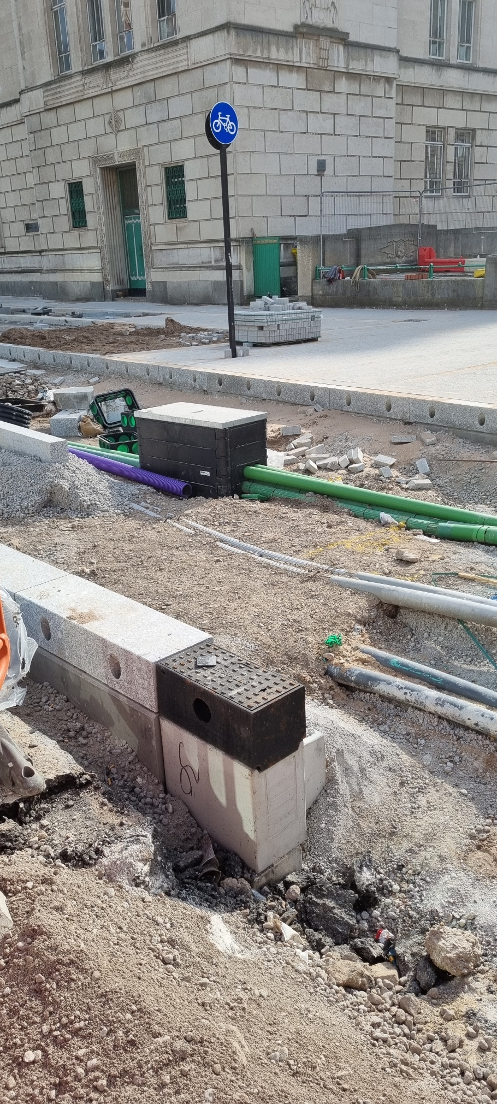
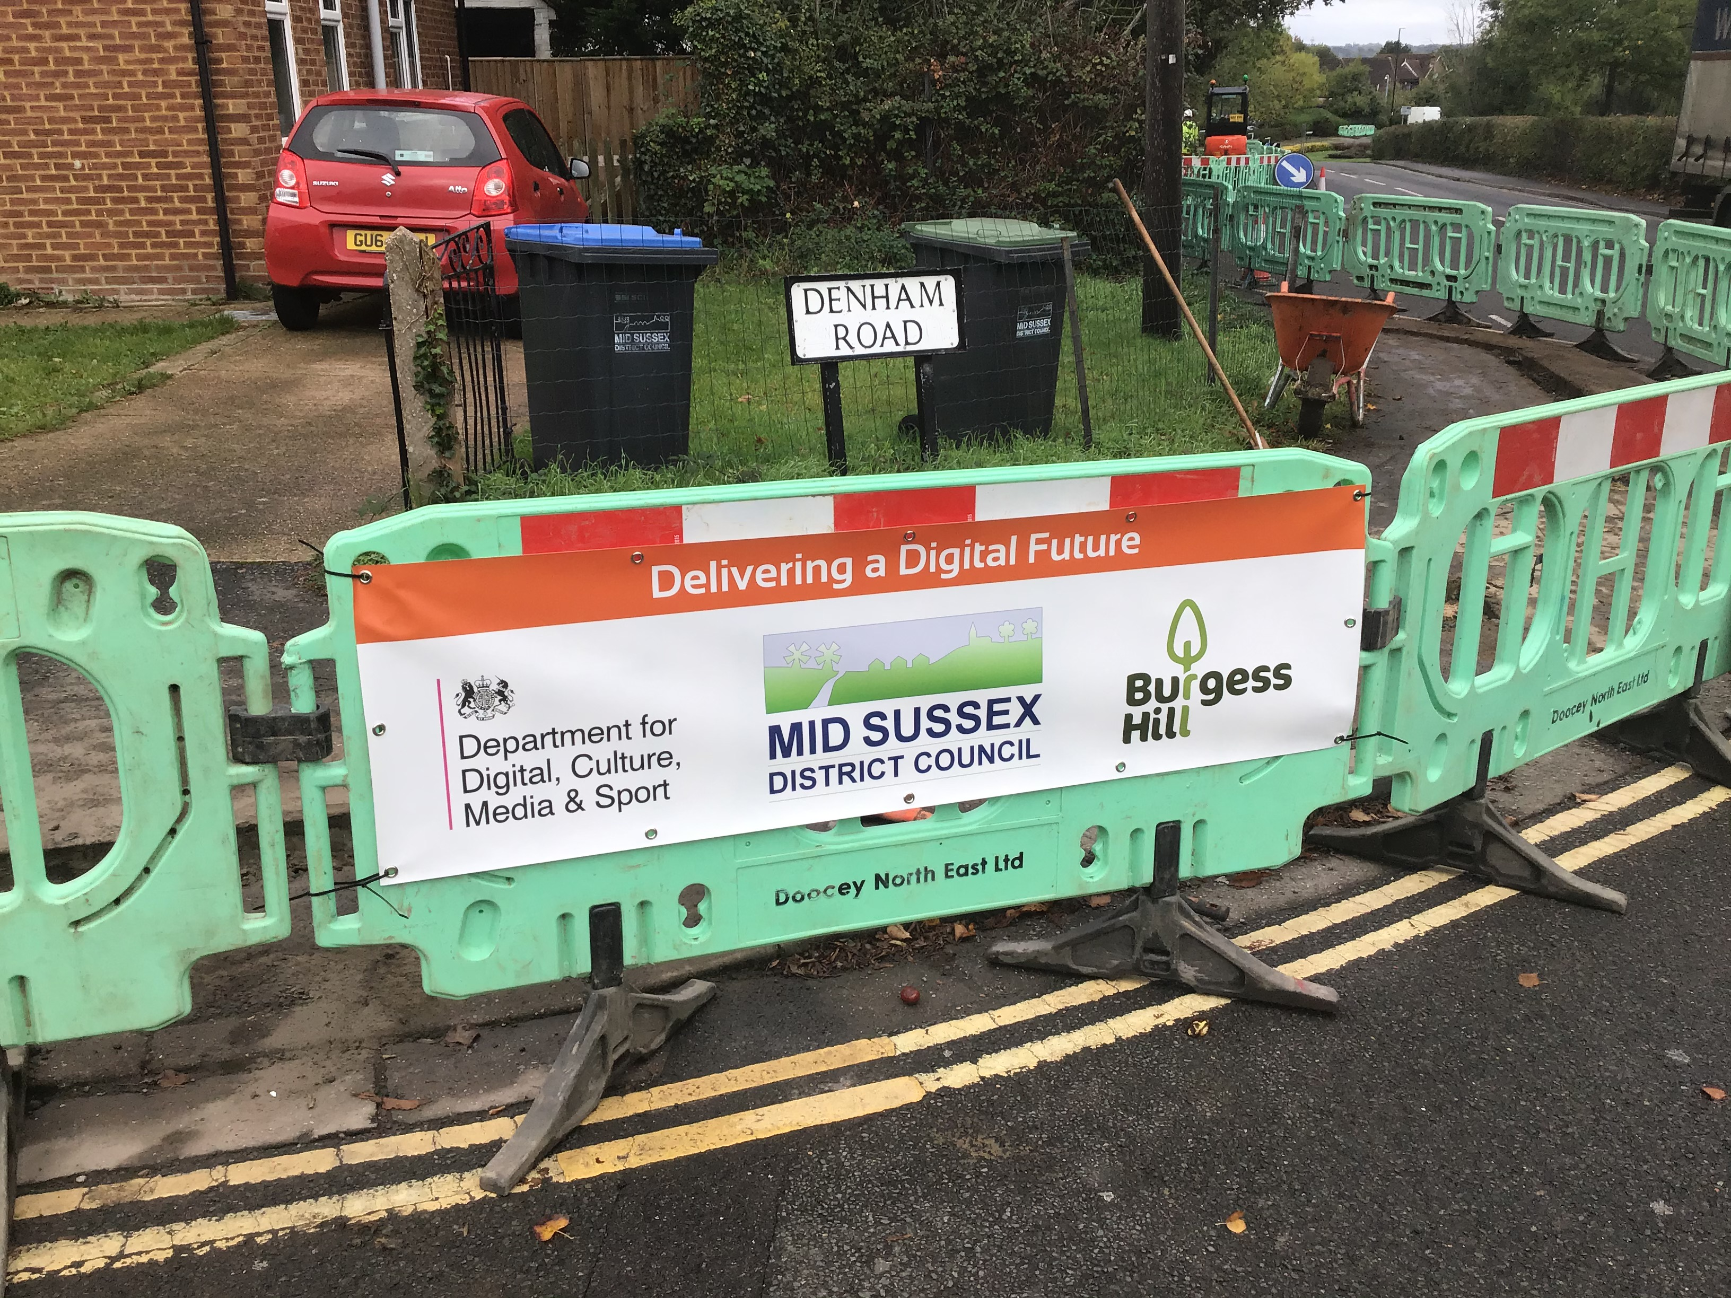
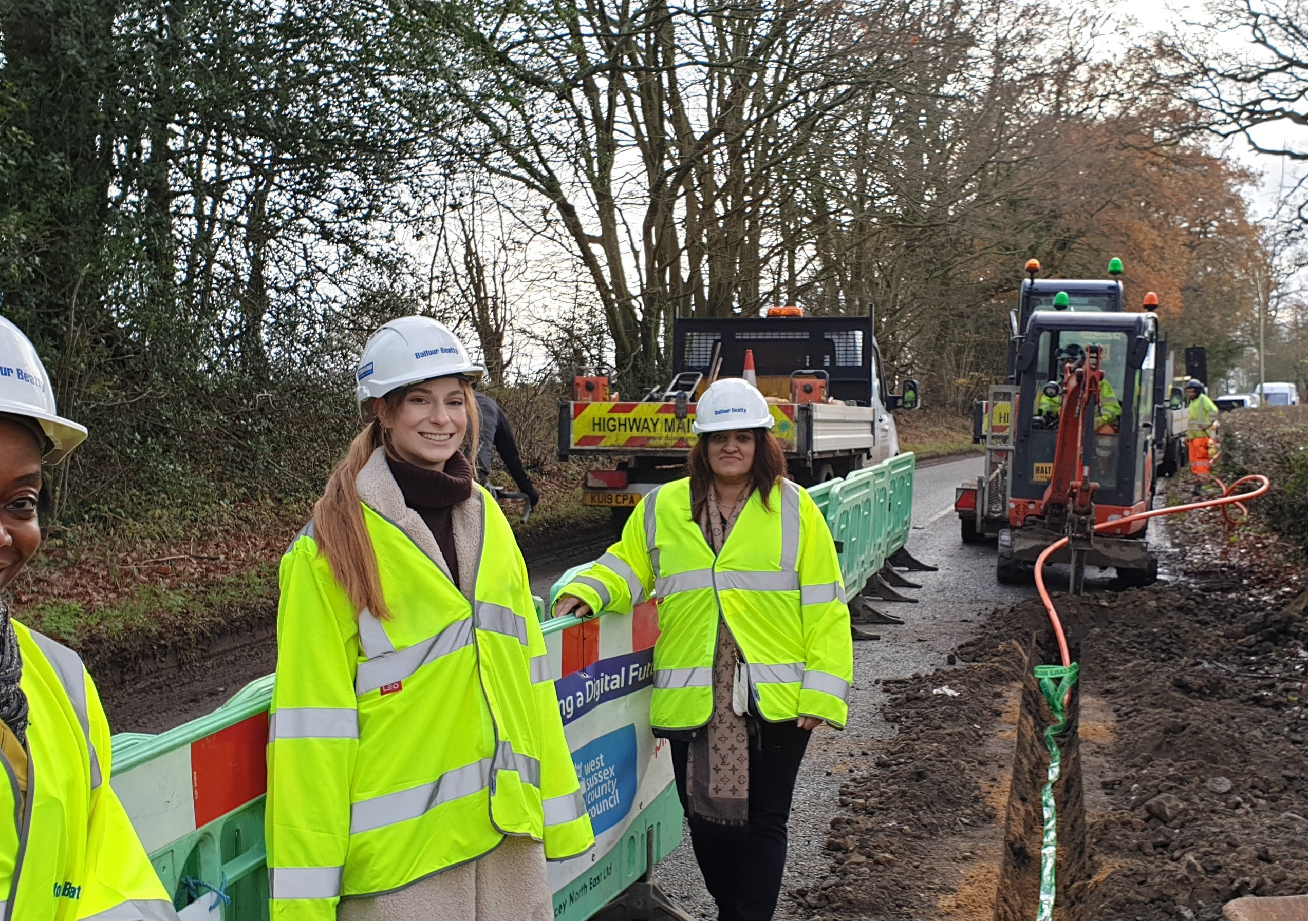
Thank you
Comments and Discussion
chris.founds@cjfoundsassociates.co.uk
M: 07931 651662
www.cjfoundsassociates.co.uk
info@cni.coop
www.cni.coop

