Slide 1
Fibre in Water
INCA Webinar: Avoiding Streetworks using alternative infrastructure

Slide 2
5G Testbeds and Trials Programme
February 2021
Notes:
Good Morning / Afternoon
My name is XXXX from the 5G Testbeds & Trials Programme in DCMS and I am delighted to be here today to talk to about the programme and what we have achieved so far.

Slide 3
Project Objectives
Propose to implement a Fibre in Water solution in the UK, initially focused on rural locations with five key objectives:
Connecting the hardest to reach areas of the UK with advanced fixed and mobile services (gigabit, 4G, 5G), supporting the UK Gigabit Programme and Shared Rural Network;
Reducing the amount of clean water leakage from the water mains (c. 20% of all clean water);
De-risking the withdrawal of the Public Switched Telephone Network (starting in 2021 and will be completed by 2025) and 2G/3G from the water industry;
Supporting digital transformation of the UK water industry; and
Enriching the Geospatial Commission’s National Underground Asset Map (NUAR).
Notes:
So what are our successes so far
●To date there have been 34 successful projects from six competitions. Between them, they cover 14 different sectors, including agritech, healthcare, manufacturing, creative industries and public services. Some of the programme key project successes are outlined below:
International impacts
● The 5GTT programme innovation model has gained international recognition with other countries looking to follow our innovative approach to investing in 5G.
Our international success is demonstrated in our work linking South Korean businesses to pilot 5G technology across the Seoul and Glasgow metro systems the joint project supports businesses in the two countries to develop and test 5G applications that explore new experiences for tourists and commuters on public transport. Furthering trade opportunities for UK companies in South Korea
●ESA joint competition launched in July Space and 5G Convergence: Transport & Logistics which is currently live. DCMS is working with UKSA and ESA to assess bids for the competition.
National successes
●Closer to home, the 5GTT Programme continuously engages and supports OGDs whether it’s supporting Ministerial dialogue to tackle specific challenges or facilitating discussions through joint working groups
●This approach has been successful in shaping the policies and priorities of OGDs through sharing lessons learned from the initial portfolio of projects.
●The work done by UK5G has had a huge impact on the interest in 5G and a (the programme has received?) very strong cross sector representation.
●The success of the 5G Create competition has been based on implementing a range of learnings accrued from previous competitions and funding awards run by the 5GTT programme.
●The competition was designed in consultation with UK5G, who advised that a market-led open-call was the best next step for the programme. As a result we have
● Within the programme and as the programme has progressed, we are seeing real 5G technical evolution from early R&D to real-world implementation- which shows how valuable the programme has been in building confidence in 5G tech across the UK. E.g. proposals in 5G Create are building on the tech that was very immature in the early phases of the programme and this shows that supporting the exploration of this technology in its early state has allowed 5G-related use cases to quickly mature and become reality.

Slide 4
Benefits to the Telecoms Industry
There are several benefits to the telecoms industry that Fibre in Water could potentially exploit:
Reducing the cost of the dig/reduced road works
Reducing the carbon footprint of deployment
Water mains reach 99.3% of premises in the UK - extended reach to rural areas
Fibre or wireless connectivity to mitigate the withdrawal of PSTN and 2G/3G in the water network

Slide 5
Benefits to the Water Industry
There are several benefits to the water industry that Fibre in Water could potentially exploit:
Reduce water leakage (c.20% in the UK)
Increased time saved finding leaks needing repairs
Water Companies can only report on leaks they find - we expect them to find more leaks so reduce leakage above the current estimated figures
Reduced time taken to locate water assets and reduced damage from inadvertent digs

Slide 6
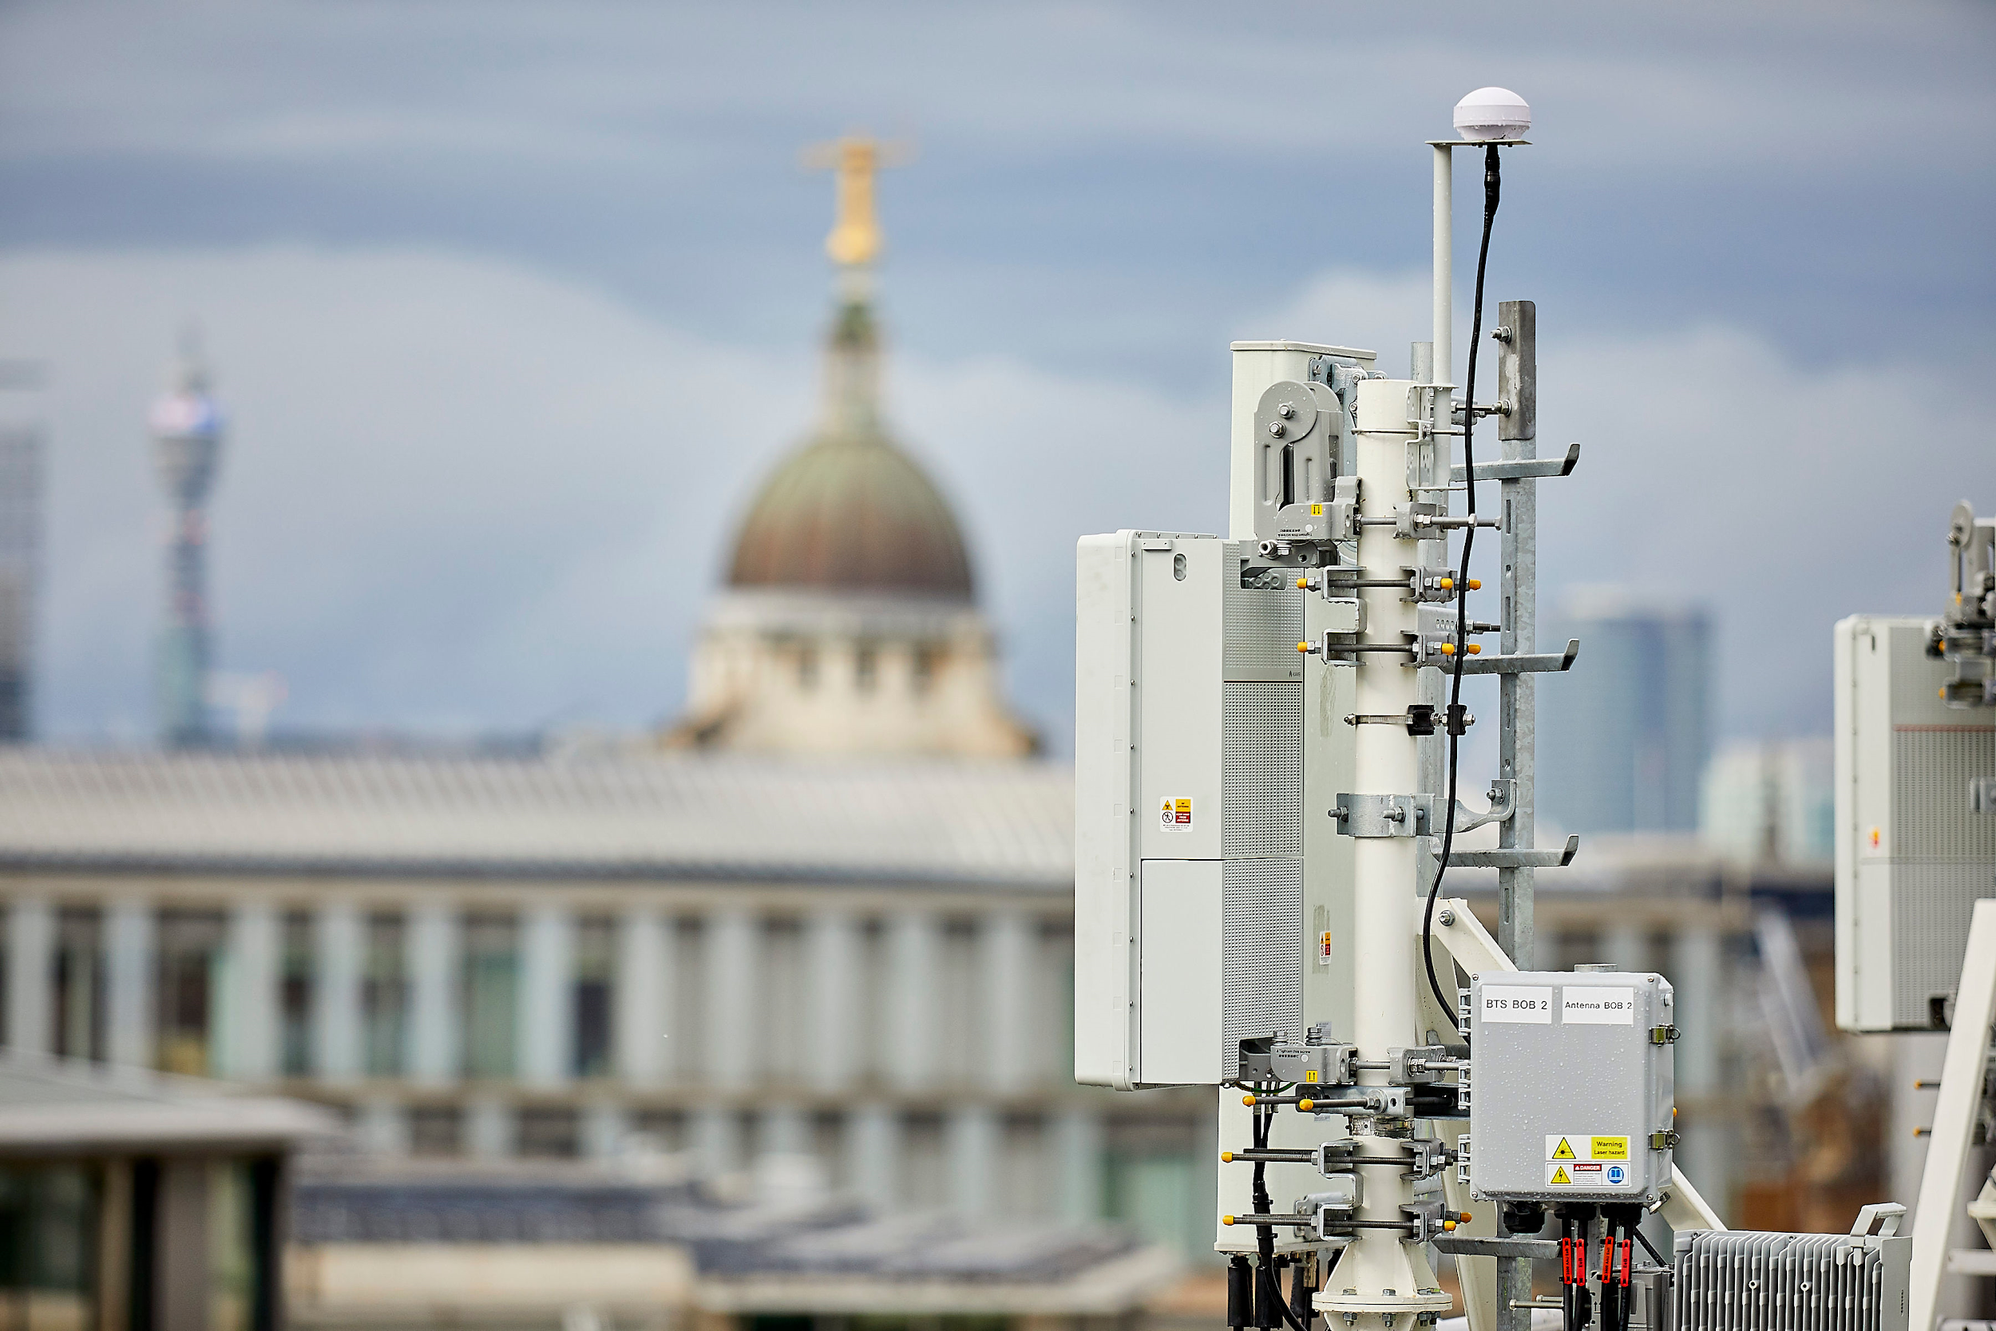
Digital Connectivity Infrastructure Accelerator (DCIA)
The project explores the challenges of using publicly owned assets to support digital infrastructure and roll out of advanced wireless connectivity.
The objectives are as follows:
Accelerating deployment of digital infrastructure by improving the ability to access and acquire sites.
Building evidence to understand the benefits and feasibility of using street furniture to host multiple technologies.
There are 4 work streams within the programme:
Digital Asset Management Platform Pilots
8 winning pilots awarded on 8th Feb
Analysis of PFI contracts relating to the use of streetlights to host small cells
Small Cell Agreements - sharing best practice
Development of Publicly Available Standards for Smart Infrastructure, in partnership with BSI
For further information: https://www.gov.uk/government/collections/digital-connectivity-infrastructure-accelerator
or email: dcia-info@dcms.gov.uk

