Slide 1
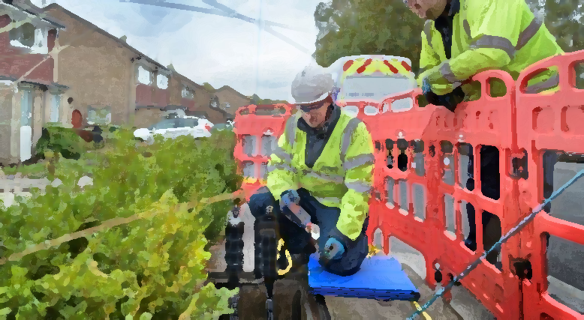
Streetworks what’s new?
David Latham Joint Chair HAUC England
Jeff Elliot Vice Chair HAUC England

Slide 2
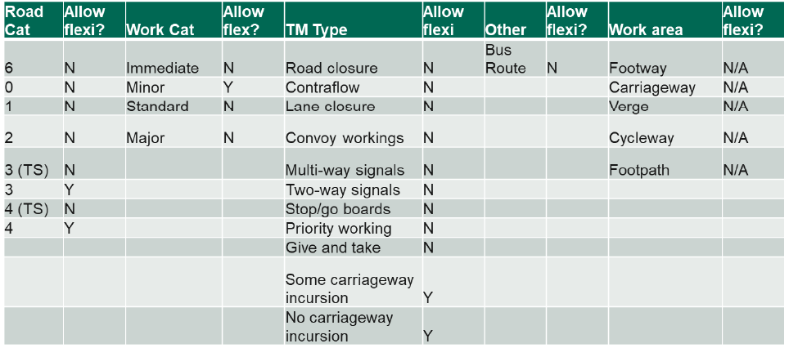
Duration 28 days
Up to 10 streets
500m or closer
All within 1.5Km
No formal traffic control
Plans 30 days in advance
Flexi permit 10 days in advance
Authority 7 days to respond
Respond by
Flexi Permits amended proposal headlines
https://www.smartsurvey.co.uk/s/QV3NY8/
Department for Transport
Street and road works reforms: follow up consultation

Slide 3
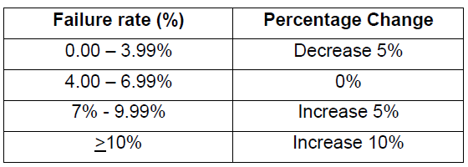
Option A Scottish Model
Inspection units based on works duration
3 options to choose from
Performance based inspection sample size
Minimum 20% sample (good performers)
Increments up or down on past 1/4 performance
5% minimum at either Cat A, B, or C
Option B
Option C
Respond by
Inspections amended proposal headlines
https://www.smartsurvey.co.uk/s/QV3NY8/
Department for Transport
Street and road works reforms: follow up consultation

Slide 4
Change and new guidance

Slide 5
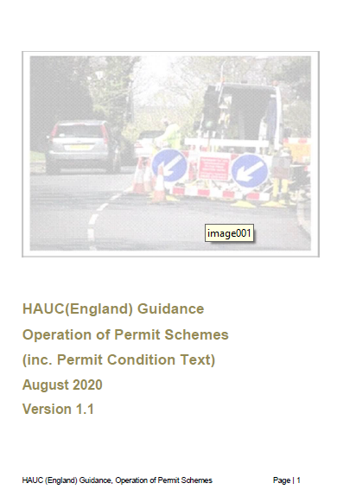
Operational guidance

Slide 6
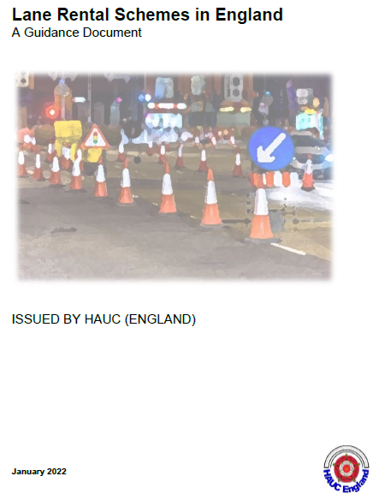
New guidance

Slide 7
Communication Channels
HAUC App https://app.hauc-uk.org.uk/
HAUC UK Website https://www.hauc-uk.org.uk/
HAUC England Bulletins
Street manager newsletters
National and regional HAUC’s
HAUC Events
Communication is Key

