Slide 1
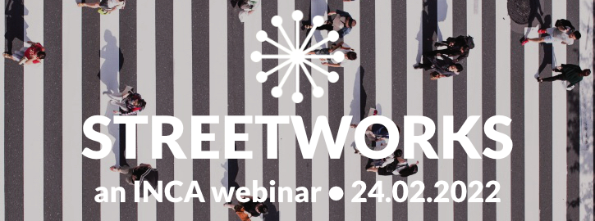
Traffic Light ducts and BOATs Alternative infrastructure

Slide 2
Traffic Light Duct
Access to Infrastructure (“ATI”) notice served on TfL on busy Farringdon Street/Clerkenwell cross-roads for Lumen as part of PIA roll-out feasibility
Survey revealed 1x, 2x, 3x, and 4x 100 mm ducts across roads
Ducting extended 100s metres away from junction due to need to “synchronise” feeder signals to avoid grid-lock
Estimated costs for entire new build £40k or more and maybe 6 – 12 months, if ever
Rent of duct likely based on PIA rates - £1,000 pa maybe

Slide 3
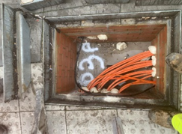
Various levels of “fill”

Slide 4
Other areas
TfL duct apparently used in London over 20 km just with traffic light signalling duct, as most is centrally controlled.
Again, feasibility of North Circular crossing revealed similar duct covers and layout
Very likely 100mm ducts in place
Would have been practically impossible to get permits
Other sampled areas include Bristol, Bath, St Albans
Two major installers and maintainers, Siemens and Peek, so designs likely to be similar across the country
Part of the “tool-kit” for new build

Slide 5
BOATs – what are they and why use them
Byways Open to All Traffic (BOATs)
BOATs carry footpath, bridleway and vehicular rights. They are normally unsurfaced. (sometimes called “Green Highways”)
They carry identical public rights to surfaced country lanes but they are, by definition, used mainly by walkers and riders.
A BOAT's surface is maintained to a standard consistent with its usage.
Statutory obligation on Local Authorities to maintain records of all byways
Got permission to use and built in Swindon
Permission in Bath and NE Somerset, and Oxfordshire County Council

Slide 6
Byways in general
In essence, if a highway of any sort is maintained by the "public purse" the rights extend to “two spits”, irrespective of the actual ownership of the underlying land.
For example London Borough of Southwark & Anor v Transport for London [2015] EWHC 3448 (Ch) (01 December 2015)
A “spit” is a spade’s depth of 12 inches
Two Spits – 24 inches or 610mm
Allows telecoms duct with 300mm cover
Another option in urban or rural areas

Slide 7
About Dolomite Solutions
Advisory work in telecoms and energy
Code Powers for Vtesse Networks, Expo-e, Connexin, Spectrum Internet (now Ogi) 4 Fibre, Why Fibre, 4th Utility, Axione Fibre, BAI (x2) and Urban Fibre.
Advice on business rates and rates relief certificates
Was instrumental in rates relief in 2016 with the Treasury over-ruling the then DCLG
Small team from Vtesse on design and physical build
Team members include staff undertaking 75,000 home FTTP network for CityFibre
Consultancy for Digital Realty, large US data centre operator
Feasibility study on Vanadium (Re)Flow batteries
Feasibility on 20MW biomass plant near Gatwick
Feasibility on Pumped Hydro Storage in south Wales
CenturyLink (now Lumen) consultancy on M&A and new build design based around PIA
Connectivity for new Google DC in Hertfordshire on unique route

Slide 8
/cont
Vtesse Networks
First operator to provide “national Ethernet”
Large financial institutions and government
Lloyds Bank, IBM, Atos, Land Registry, CLS
Regulated by US Federal Reserve – handled up to $1 trillion a day
Refurbish former IBM data centre
Upgrade to 6MVA
Design and build of Stellium Cobalt Business Park fibre routes
Sold to Interoute 2014

Slide 9
Aidan Paul, MD
Initial work of first generation APDs supplied to BT for replacing coax network with fibre
Advice to UK Government on cable TV standards and IEEE 802.3 MAN standard
Sent to attend IEEE 802.3 Ethernet standards committee by UK , and named in standard
6 year involvement and on ANSI, BSI and IEE committees on LAN standards
Started BICC Data Networks, acquired by 3Com
Robert Fleming & Co – late 80s – 90s
Cable TV financing
KCOM financing
$510 m satellite finance – largest start-up financing in 1990s
Equity from BAe, Matra, General Dynamics, Nissho Iwai, ComDev, Kingston Communications, Telecom Italia
First satellite in 1992 carried UK Lottery traffic
Raised £27m for ill-fated Ionica FWA operator
Alliant Partners, now part of Silicon Valley Bank 1996 - 1999
M&A for 3i and got offer from Sony for Matra GSM handset business for $200m

