Slide 1
INCA New Telegraph Poles
Matt Smith Full Fibre Ltd

Slide 2
Overhead fibre dramatically reduces the disruption and damage
Its relatively quick to deploy and much more cost effective
Roughly half of UK homes are currently fed from existing poles
All new estates are UG ducted as are most town centres
Major issue on 1970’s/80’s suburban estates
Not a feasible option to retro duct on a wholesale basis
The Electronic Communications Code provides the legal framework to install new poles as permitted development

Slide 3
Most providers polling not digging in direct bury areas (with a couple of exceptions)
Openreach
City Fibre
Netomnia
Gigaclear – in Urban
And the rest of us
But they are not popular and mistakes are being made

Slide 4
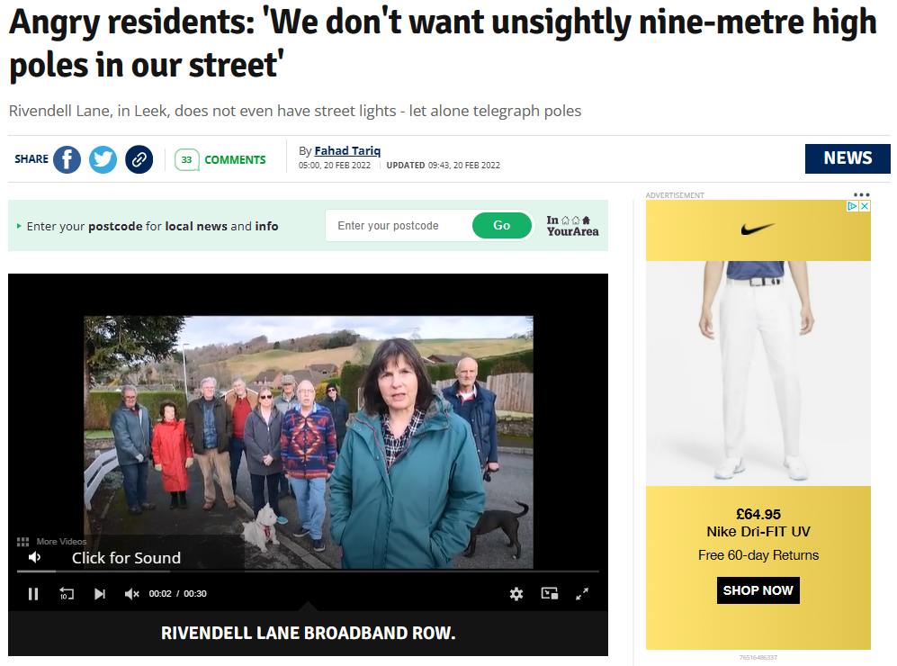
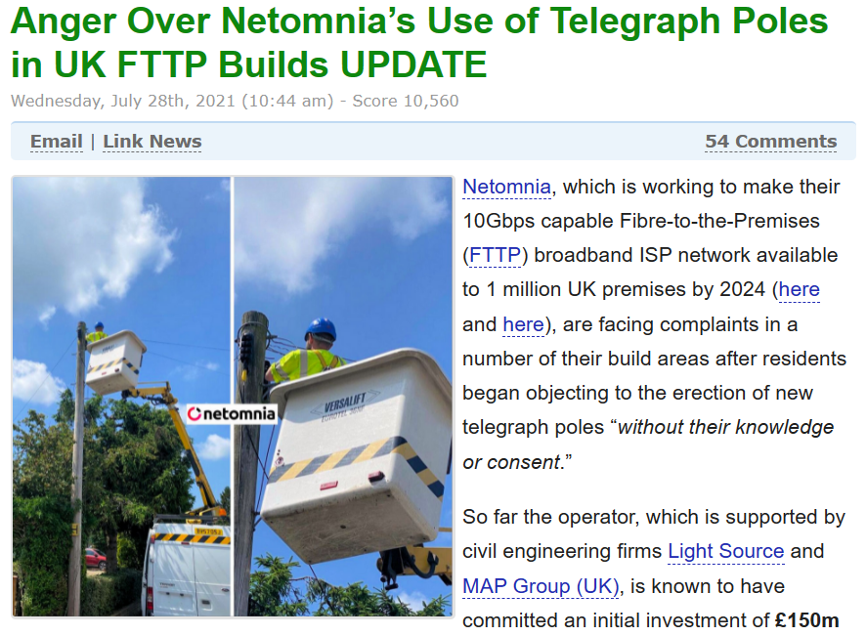
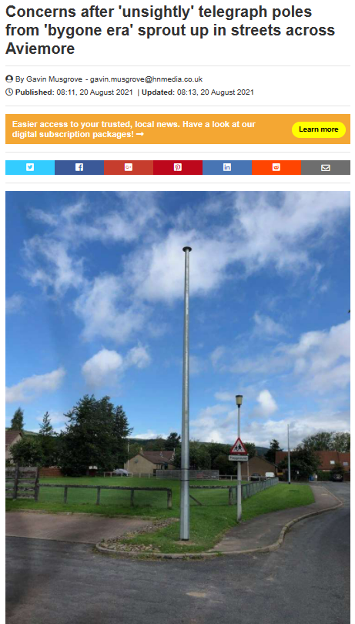
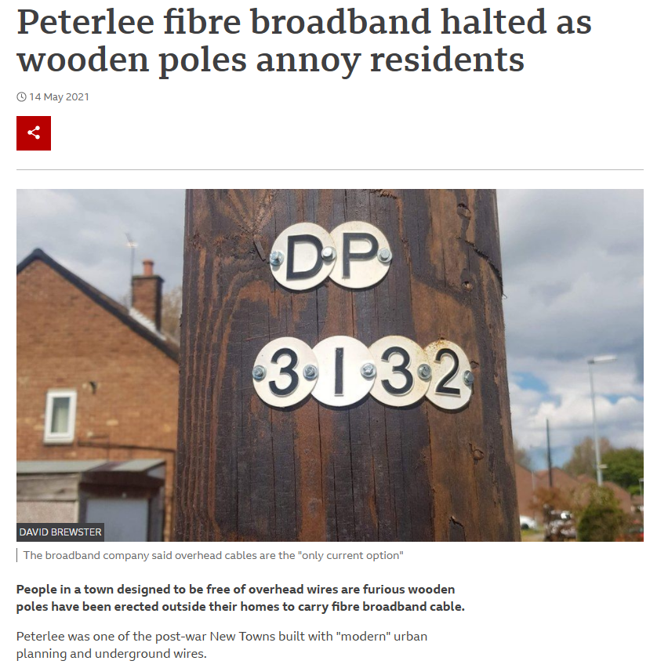
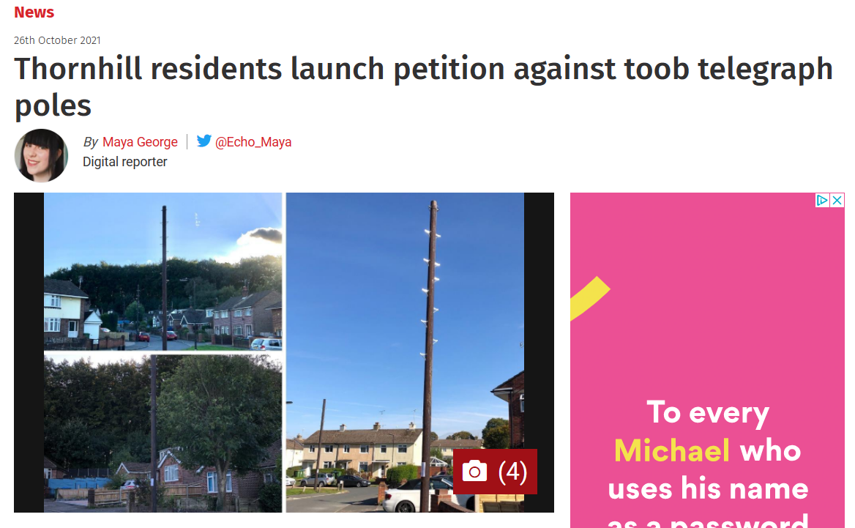
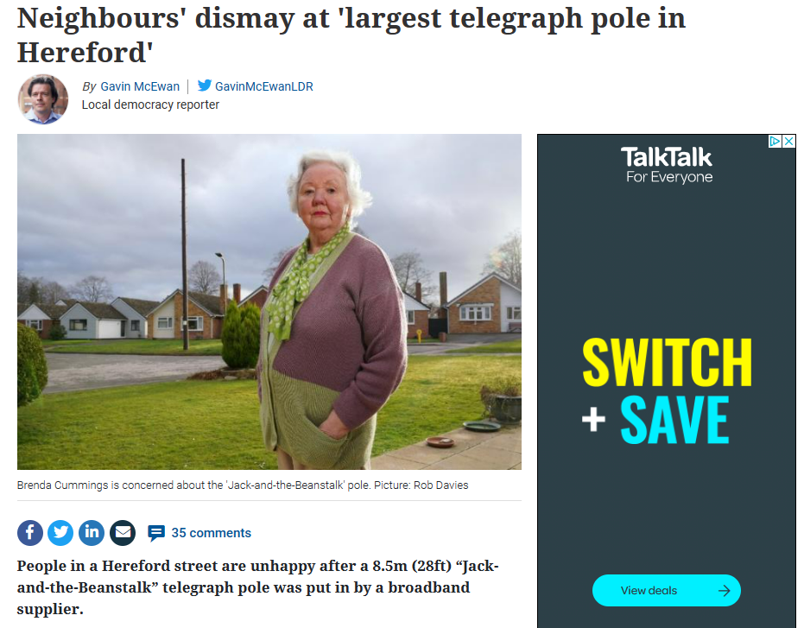
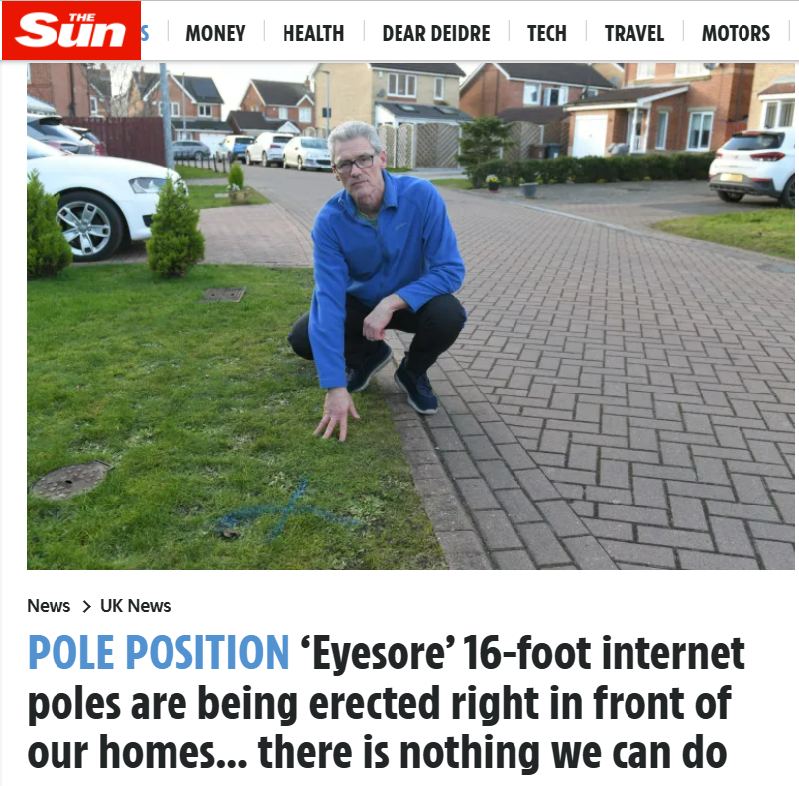
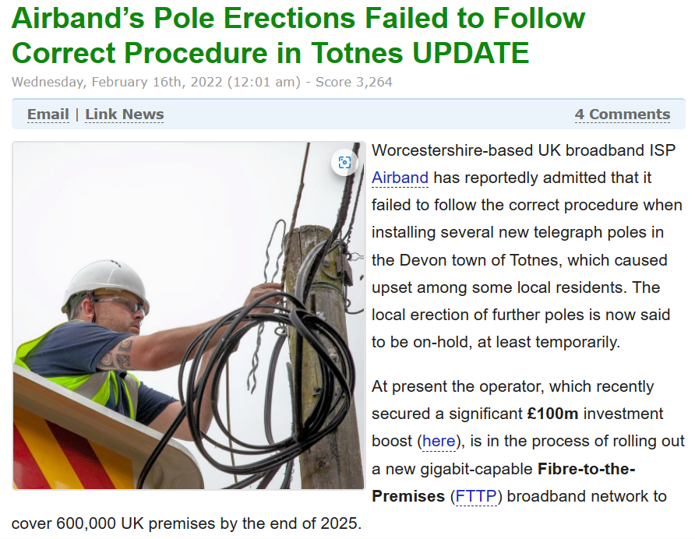

Slide 5
View is this is archaic but poles will be a fundamental part of the UK connectivity network for decades to come
Planning and surveying issues
Noticing issues
Different approaches Openreach after the fact, others more consultative
Complaints and political issues
This is the really difficult stuff but everyone’s programmes will ramp up very soon

